Slide 1

Realizable Accessibility: Evaluating the Reliability of Public Transit Accessibility using High-resolution Real-time Data
Luyu Liu, Adam Porr, Harvey J. Miller
Department of Geography
The Ohio State University
(liu.6544@osu.edu, porr.4@osu.edu, miller.81@osu.edu)
2022/2/28

Slide 2
What is accessibility?
Accessibility is your ability to reach different places
Example: How far can you go in 30 minutes?
Example: How many jobs you can commute to by bus in 15 minutes?
Accessibility is your freedom to move, which public transit usually lacks

Slide 3
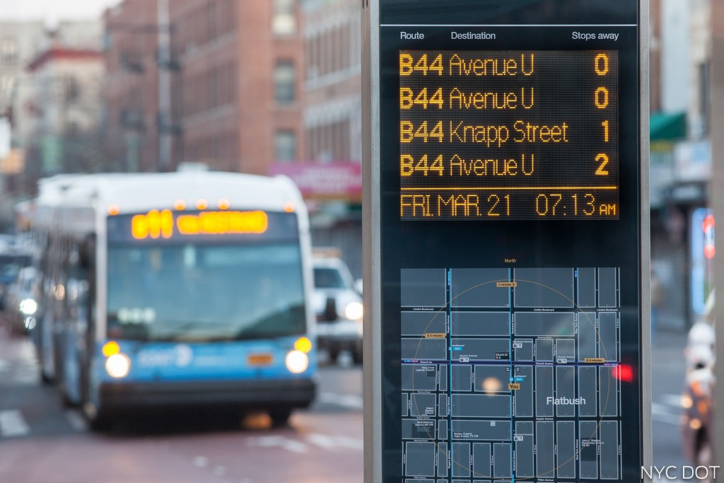
Scheduled data is not real
Scheduled data is not reliable
Expected/scheduled time
Delay: traffic, weather, random disturbances
Real-time data is more reliable
Actual arrival time
What users experience
Source

Slide 4
Why not measure with the actual time?
Why not change the scheduled time to the real-time time?
Keep the well-established model
Yes, people did:
Wessel, Allen, Farber (2017) and Wessel and Farber (2019) retrospectively calculate the real-time accessibility
Retrospective: collect historical actual arrival time and calculate accessibility
They found that the retrospective real-time accessibility are significantly different from the scheduled accessibility
Is it the end of the discussion?

Slide 5
Is retrospective real-time accessibility realistic?
Short answer: No. It assumes clairvoyance or perfect real-time information
No one can tell buses’ actual arrival time before taking the bus
Some maneuvers are possible retrospectively, but normal passengers cannot foresee it
What you planned can be different from what you take
It’s like buying lottery when you already know the number

Slide 6
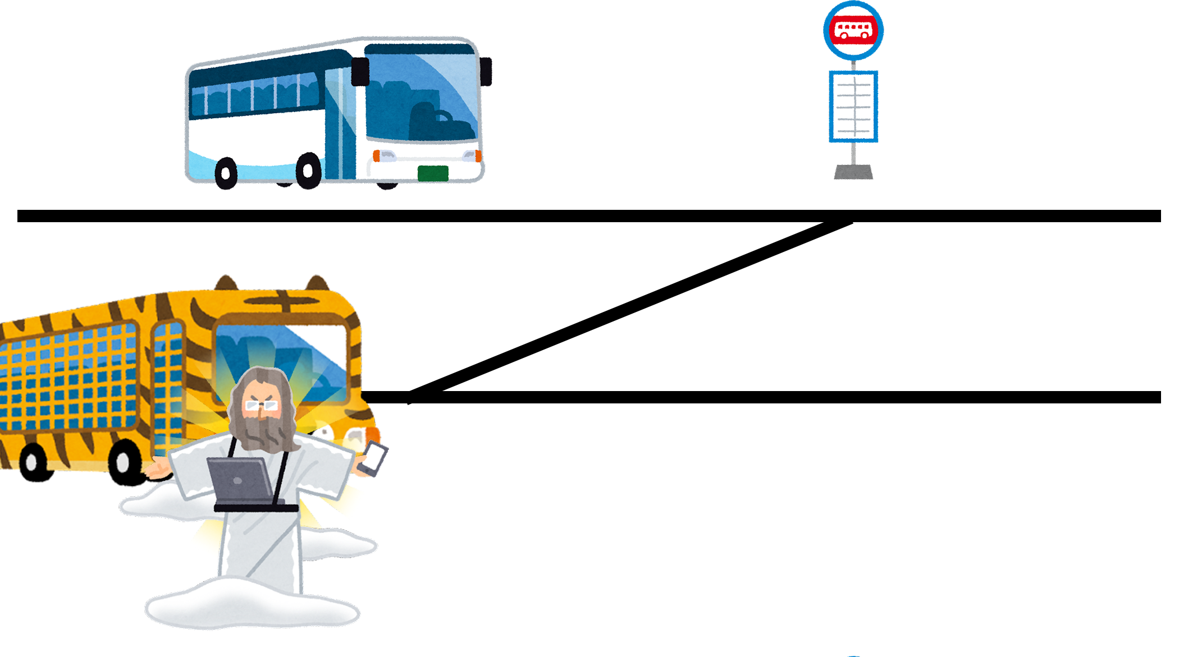
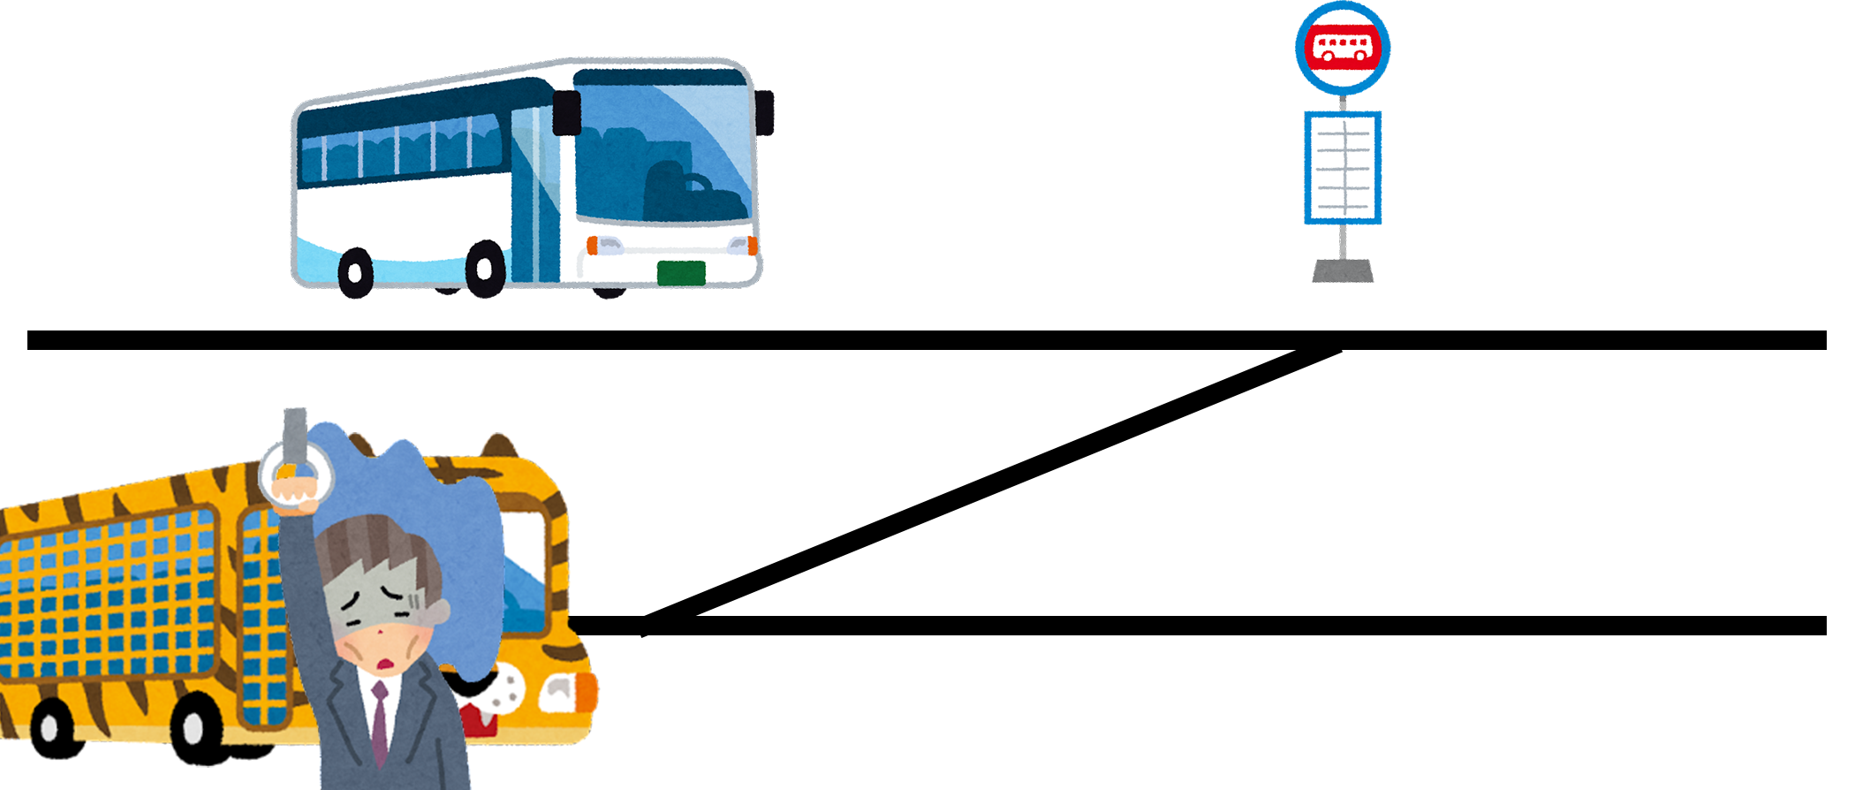
Example: taking a transfer
Scientists with full archive of the historical real-time data
Normal passengers who can only access schedule data and current real-time data
I predict that bus will be delayed for 2 minutes, just enough for me to catch it, so this transfer is possible
The schedule says I won’t make it to the bus, so I better choose another route though there is a slim chance that bus may be delayed

Slide 7
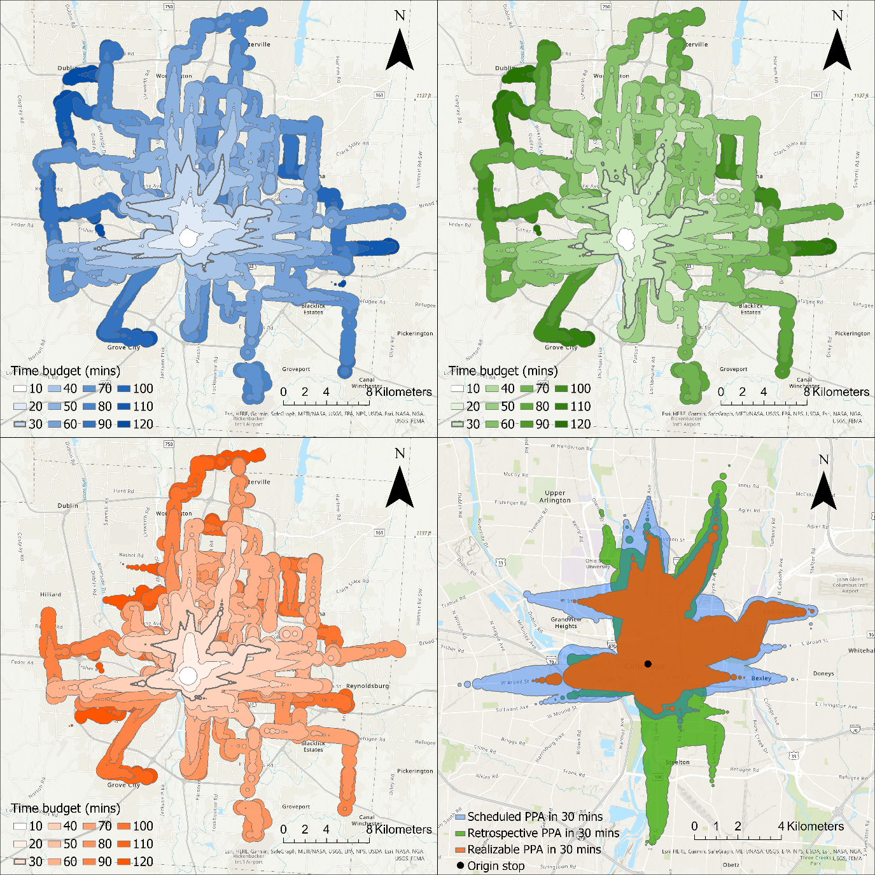
Realizable accessibility
Two step behavioral process
First plan with scheduled times, which are available beforehand.
Then implement with actual times.
Just like what humans do
More conservative
Example: realizable accessibility has smallest reachable area in 30 minutes

Slide 8
Three scenarios
Blue: scheduled, expectation from public authorities
Green: retrospective, overestimation by scientists
Orange: realizable, reality of passengers

Slide 9
How unreliable is public transit?
Unreliability: the difference between realizable and scheduled accessibility
It is the degree of broken promise
Example: How far you can go from Columbus downtown in the real world (orange) versus in the schedule (blue)

Slide 10
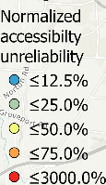
Does unreliability change over space?
Each point is a person trying to reach as far as possible
Color indicates unreliability
Blue: lower
Red: higher
For more practical time budget (15 – 30 minutes), accessibility in the city center is more unreliable

Slide 11
Spread of unreliability
Unreliability start from city center, spread to the suburban with higher time budget
Unreliability reaches saturation with long time budget
Downtown has low unreliability then
Because both scheduled and realizable can reach the city boundary
Does not mean overall unreliability is better

Slide 12
Conclusions
We often overestimate the accessibility generated by transit
We should be more conservative when planning transit systems
Transit systems should be more about humans, less about system

